Slide 1

Assembling Data to Fight Cancer
Paul Marcum
Director, Global Digital Marketing & Programming
GE
@jpmarcum

Slide 2
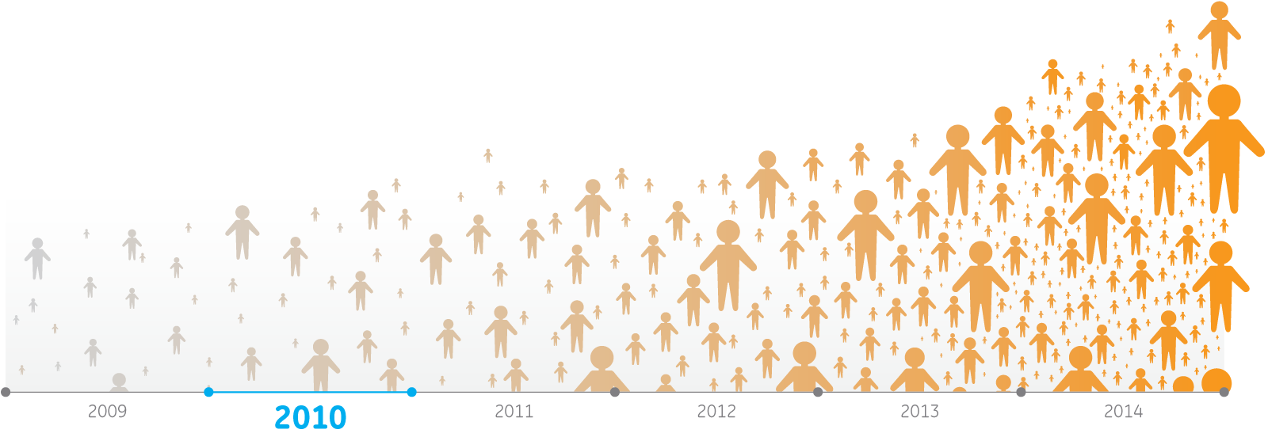
Our Cancer Commitment
  50 Years in the oncology space
  GE Healthcare a world leader in diagnostic technologies
  healthymagination is a $6B investment in programs and technologies to provide better health to more people
  Over the next five years we’ll be dedicating $1B to the development of new oncology solutions
We see the day when cancer
is no longer a deadly disease

Slide 3
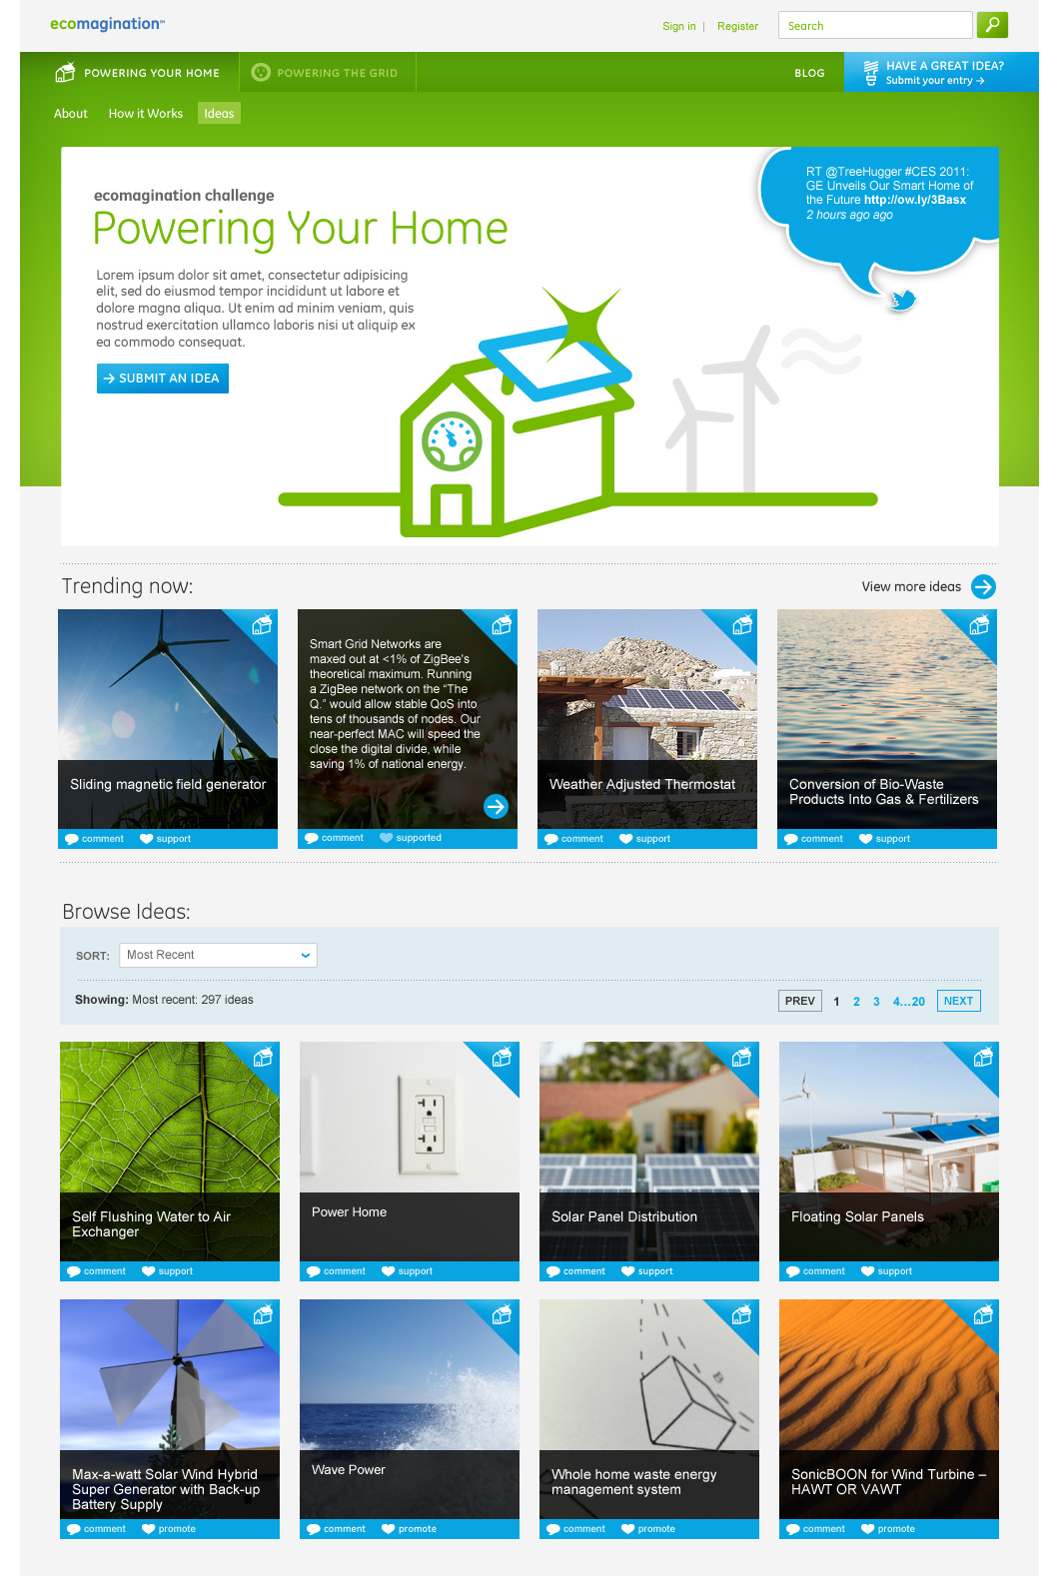
Open Innovation: ecomagination challenge
  $134MM invested in sustainable energy
  22 investments and commercial partnerships; completed one acquisition
  Through innovation awards we granted $1.1MM to early stage entrepreneurs

Slide 4
Assembling Tools to Fight Cancer
  $100MM fund to advance breast cancer diagnostics through open innovation
  Partnership with Kleiner Perkins Caufield & Byers, Venrock Capital, Mohr Davidow and MPM Capital
  Initial challenge runs until November 20, 2011:
    Breast cancer pathways: Map breast cancer pathways independent of classic hormone dependent signaling
    Molecular similarities between tumors: Map the molecular/proteomic similarities between breast cancer and other solid tumors

Slide 5
We see data as critical to improved outcomes for breast cancer patients
In partnership with O’Reilly, this fall we’re bringing together our data and partner data in an accessible, open platform – and a template for best practices
We’ll be enlisting the data scientist community for your guidance and participation
We’ll be announcing a series of challenges and prizes for data scientists to analyze the data and improve accessibility

Slide 6



Launch Data
MQIC: A de-identified subset of the 18 million lives we track through the centricity family of EMRs
Premier Research Services: De-identified data on roughly 56 million inpatients dating back to 2000 and 275+ million outpatients
Clarient: Tracking cancer at the molecular level

Slide 7
To Learn More
Panel at Strata Conference on Friday @ 2:30PM
data.healthymagination.com to sign up for email announcements on data challenge
challenge.healthymagination.com to visit breast cancer challenge
@jpmarcum

